Slide 1
Introduction to the course “Software engineering and information system design”

Slide 2
contents
Course introduction
Course description
Learning outcomes
Rationale (importance of software engineering)

Slide 3
Course introduction
Course Name: Software engineering and information system Design
Course Code: CSTE 3205

Slide 4
Course description
Credit hours: 3.0
Textbook(s)
Software Engineering, A Practitioner's approach
Roger S. Pressman, 8th Edition, McGraw Hill
Software Engineering
I. Sommerville, 10th Edition, Pearson Education
Resources:
Textbook(s)
Class lectures/slides
Exercises provided in your textbook(s)
Class schedule as per the class routine.
Please join virtual classroom for your class update. (Code: jkicvvj)

Slide 5
Learning outcomes
Understand the fundamentals of software engineering, including development process models, requirement engineering, design principles, testing, maintenance, and ethical responsibilities of software professionals,
Apply software engineering knowledge to identify the challenges of complex software engineering problems,
Analyze the challenges of software engineering problems to decide functional, nonfunctional, and domain requirements to produce efficient, reliable and cost-effective software solutions, and
Recognize ethical and professional responsibilities in engineering situations and make informed judgments which must consider the impact of engineering solutions in global, economic, environmental and societal contexts.

Slide 6
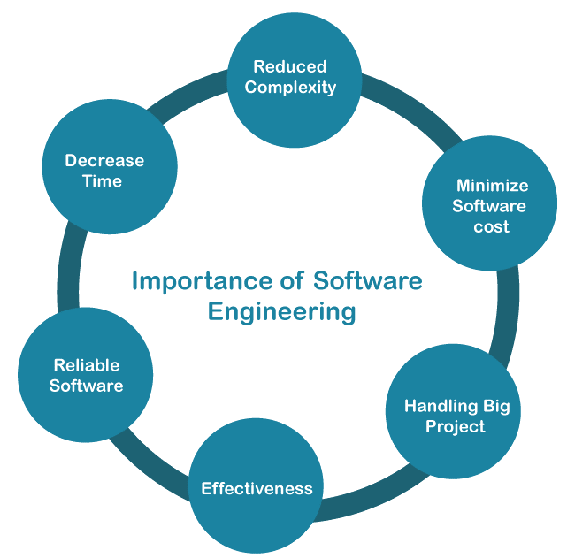
Rationale

Slide 7
What is Software?
Software is a collection of executable program codes, associated libraries, and documentation.
Software is:
instructions (computer programs) that when executed provide desired features, function, and performance;
data structures that enable the programs to adequately manipulate information; and
documentation that describes the operation and use of the programs.

Slide 8
Characteristics of software
Software is developed or engineered, it is not manufactured in the classical sense.
Software doesn't "wear out."
Although the industry is moving toward component-based construction, most software continues to be custom-built.
Observations:
Much software has poor design and is getting worse
We have to learn to ‘engineer’ software

Slide 9
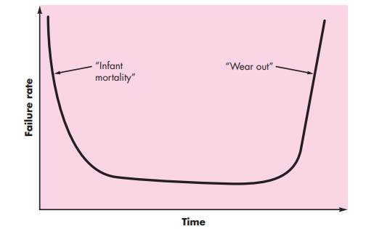
Failure curve for hardware

Slide 10
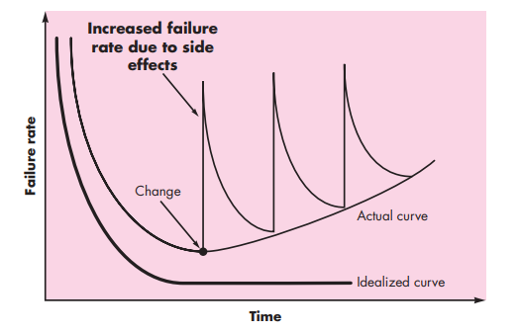
Failure curve for software

Slide 11
Evolving role of software
Software takes on a dual role.
A product: delivers the computing potential
Produces, manages, and displays the information.
A vehicle for delivering a product: used to deliver the product (process).
It supports or directly provides system functions.
Controls other programs (Ex. Operating systems)
Effects communications (Ex. Networks)
Helps in building other software (Ex. Software tools)

Slide 12
Contd…
It is an information transformer.
Producing, managing, acquiring, modifying, displaying, or transmitting information that can be as simple as a single bit or as complex as a multimedia presentation derived from data acquired from dozens of independent sources.

Slide 13
Changing nature of software
Software keeps on changing from one situation to another.
System software: collection of programs written to provide service for other programs (ex. compilers, file management utilities, editors)
Application software: designed to help users to perform specific task (ex. C, JAVA)
Engineering and scientific software: for complicated numeric calculations (ex. Calculus, statistics)
Embedded software: It lies in hardware of system and used for control functions (ex. Microwave oven controls)
Product line software: It provides specific capabilities for software engineering (ex. Computer graphics, DBMS)
Web application software: These are used for networking (ex. Websites)
Artificial intelligence software: Non-numeric applications to solve complex problems. Including robotics, expert systems, pattern recognition (image and voice), artificial neural networks, theorem, proving, and game playing.

Slide 14
Legacy software
Legacy implies that the software is out of date or in need of replacement, however it may be in good working order so the business or individual owner does not want to upgrade or update the software.
very old software
developed decades ago
inextensible design
no documentation
cannot meet needs of new technologies

Slide 15
Why legacy software must be changed?
software must be adapted to meet the needs of new computing environments or technology.
software must be enhanced to implement new business requirements.
software must be extended to make it interoperable with other more modern systems or databases.
software must be re-architected to make it viable within a network environment.

Slide 16
Characteristics of webapps
network intensiveness. a webapp resides on a network and must serve the needs of a diverse community of clients.
concurrency. a large number of users may access the webapp at one time.
unpredictable load. the number of users of the webapp may vary by orders of magnitude from day to day.
performance. if a webapp user must wait too long (for access, for server-side processing, for client-side formatting and display), he or she may decide to go elsewhere.
availability. although expectation of 100 percent availability is unreasonable, users of popular webapps often demand access on a “24/7/365” basis.

Slide 17
Contd…
data driven. the primary function of many webapps is to use hypermedia to present text, graphics, audio, and video content to the end-user.
content sensitive. the quality and aesthetic nature of content remains an important determinant of the quality of a webapp.
continuous evolution. unlike conventional application software that evolves over a series of planned, chronologically-spaced releases, web applications evolve continuously.
immediacy. although immediacy—the compelling need to get software to market quickly—is a characteristic of many application domains, webapps often exhibit a time to market that can be a matter of a few days or weeks.
security. because webapps are available via network access, it is difficult, if not impossible, to limit the population of end-users who may access the application.
aesthetics. an undeniable part of the appeal of a webapp is its look and feel.

Slide 18
SoFTware engineering
The IEEE definition:
Software Engineering is
The application of a systematic, disciplined, quantifiable approach to the development, operation, and maintenance of software; that is, the application of engineering to software.
The study of approaches as in (1).

Slide 19
Contd…
The process of solving customers’ problems by the systematic development and evolution of large, high-quality software systems within cost, time and other constraints.

Slide 20
Contd…
Solving customers’ problems
The goal
Sometimes the solution is to buy, not build
Adding unnecessary features often makes software worse
Software engineers must communicate effectively to identify and understand the problem

Slide 21
Contd…
Systematic development and evolution
An engineering process involves applying well understood techniques in an organized and disciplined way
Many well-accepted practices have been formally standardized
e.g. by the IEEE or ISO
Most development work is evolution

Slide 22
Contd…
Large, high quality software systems
software engineering techniques are needed because large systems cannot be completely understood by one person
teamwork and co-ordination are required
key challenge: dividing up the work and ensuring that the parts of the system work properly together
the end-product must be of sufficient quality

Slide 23
Contd…
Cost, time and other constraints
finite resources
the benefit must outweigh the cost
others are competing to do the job cheaper and faster
inaccurate estimates of cost and time have caused many project failures

Slide 24
Software Quality
Usability - users can learn it and fast and get their job done easily
Efficiency - it does not waste resources such as CPU time and memory
Reliability - it does what it is required to do without failing
Maintainability - it can be easily changed
Reusability - its parts can be used in other projects, so reprogramming is not needed

Slide 25
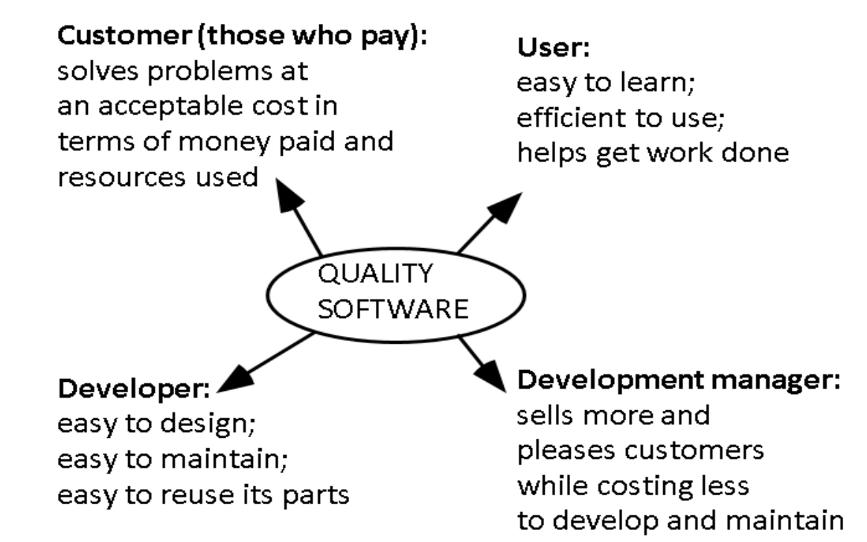
Software quality and stakeholders

Slide 26
General issues that affect software
Heterogeneity
Increasingly, systems are required to operate as distributed systems across networks that include different types of computer and mobile devices.
Business and social change
Business and society are changing incredibly quickly as emerging economies develop and new technologies become available. they need to be able to change their existing software and to rapidly develop new software.
Security and trust
As software is intertwined with all aspects of our lives, it is essential that we can trust that software.
Scale
Software has to be developed across a very wide range of scales, from very small embedded systems in portable or wearable devices through to Internet-scale, cloud-based systems that serve a global community.

Slide 27
Software project failure
Increasing system complexity
As new software engineering techniques help us to build larger, more complex systems, the demands change. Systems have to be built and delivered more quickly; larger, even more complex systems are required; systems have to have new capabilities that were previously thought to be impossible.
Failure to use software engineering methods
It is fairly easy to write computer programs without using software engineering methods and techniques. Many companies have drifted into software development as their products and services have evolved. They do not use software engineering methods in their everyday work. Consequently, their software is often more expensive and less reliable than it should be.

Slide 28
Software myths
3 myths
Management myths
Customer myths
Developers/practitioners myths

Slide 29
Software Myths- management myths
Available standards and procedures are enough.
We can add workers when we get behind the schedule.
We can outsource the project to third party and relax. they will take care of the project.

Slide 30
Software Myths- customer myths
General statement of project is enough, details can be filled later.
Software requirements can be changed easily because software is flexible.

Slide 31
Software Myths- Developers/practioners myths
Once the program is written, job is done.
Until program starts to run, there is no way to access the quality.
The only deliverable work product is the software program code.

Slide 32
Software engineering- a layered technology
tools
methods
process model
a “quality” focus
Software engineering

Slide 33
The Software process
A process is a collection of activities, actions, and tasks that are performed when some work product is to be created.
An activity strives to achieve a broad objective (e.g., communication with stakeholders) and is applied regardless of the application domain, size of the project, complexity of the effort, or degree of rigor with which software engineering is to be applied.
An action (e.g., architectural design) encompasses a set of tasks that produce a major work product (e.g., an architectural design model).
A task focuses on a small, but well-defined objective (e.g., conducting a unit test) that produces a tangible outcome

Slide 34
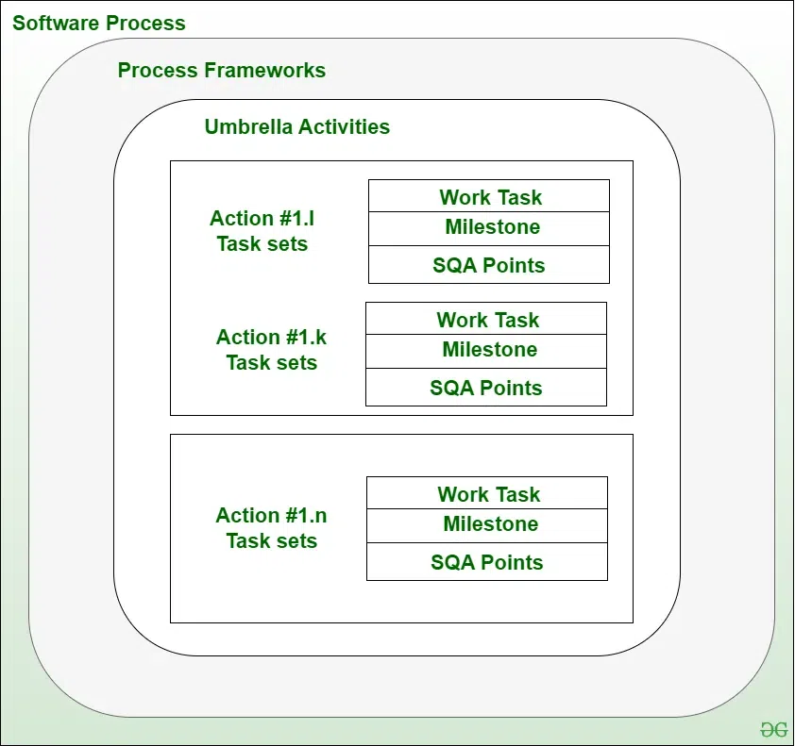
A process framework
Process Framework: Establishing a Foundation for software engineering by identifying small no of framework and umbrella activities that are applicable for entire software process.
Framework Activities
Work Tasks
Work Products
Milestones And Deliverables
SQA Checkpoints
Umbrella Activities

Slide 35
Framework activities
Communication
Planning
Modeling
Analysis of Requirements
Design
Construction
Code Generation
Testing
Deployment

Slide 36
Umbrella activities
Software project tracking and control
allows the software team to assess progress against the project plan and take any necessary action to maintain the schedule.
Formal technical reviews
assesses software engineering work products in an effort to uncover and remove errors before they are propagated to the next activity.
Software quality assurance
defines and conducts the activities required to ensure software quality.
Software configuration management
manages the effects of change throughout the software process

Slide 37
Contd…
Work Product Preparation and Production
Encompasses The Activities Required To Create Work Products Such As Models, Documents, Logs, Forms, And Lists
Reusability Management
Defines Criteria For Work Product Reuse (Including Software Components) And Establishes Mechanisms To Achieve Reusable Components.
Measurement
Defines And Collects Process, Project, And Product Measures That Assist The Team In Delivering Software That Meets Stakeholders’ Needs; Can Be Used In Conjunction With All Other Framework And Umbrella Activities
Risk Management
Assesses Risks That May Affect The Outcome Of The Project Or The Quality Of The Product.

Slide 38
Adapting a process model
The overall flow of activities, actions, and tasks and the interdependencies among them
The degree to which actions and tasks are defined within each framework activity
The degree to which work products are identified and required
The manner which quality assurance activities are applied
The manner in which project tracking and control activities are applied
The overall degree of detail and rigor with which the process is described
The degree to which the customer and other stakeholders are involved with the project
The level of autonomy given to the software team
The degree to which team organization and roles are prescribed

Slide 39
The essence of practice
Polya suggests:
1. Understand the problem (Communication and Analysis).
2. Plan a solution (Modeling and Software Design).
3. Carry out the plan (Code Generation).
4. Examine The Result For Accuracy (Testing And Quality Assurance).

Slide 40
Understand the problem
Who has a stake in the solution to the problem? that is, who are the stakeholders?
What are the unknowns? what data, functions, and features are required to properly solve the problem?
Can the problem be compartmentalized? is it possible to represent smaller problems that may be easier to understand?
Can the problem be represented graphically? can an analysis model be created?

Slide 41
Plan the solution
Have you seen similar problems before? are there patterns that are recognizable in a potential solution? is there existing software that implements the data, functions, and features that are required?
Has a similar problem been solved? if so, are elements of the solution reusable?
Can subproblems be defined? if so, are solutions readily apparent for the subproblems?
Can you represent a solution in a manner that leads to effective implementation? can a design model be created?

Slide 42
Carry out the plan
Does the solution conform to the plan? is source code traceable to the design model?
Is each component part of the solution provably correct? has the design and code been reviewed, or better, have correctness proofs been applied to algorithm?

Slide 43
Examine the result
Is it possible to test each component part of the solution? has a reasonable testing strategy been implemented?
Does the solution produce results that conform to the data, functions, and features that are required? has the software been validated against all stakeholder requirements?

Slide 44
Hooker’s general principles
1: The reason it all exists: to provide value to its users.
2: keep it simple, stupid!: all design should be as simple as possible, but no simpler.
3: maintain the vision: a clear vision is essential to the success of a software project.
4: what you produce, others will consume: , always specify, design, and implement knowing someone else will have to understand what you are doing
5: be open to the future : never design yourself into a corner.
6: plan ahead for reuse: planning ahead for reuse reduces the cost and increases the value of both the reusable components and the systems into which they are incorporated
7: think!: .placing clear, complete thought before action almost always produces better results.

Slide 45
Software engineering ethics
Software engineering involves wider responsibilities than simply the application of technical skills.
Software engineers must behave in an honest and ethically responsible way if they are to be respected as professionals.
Ethical behaviour is more than simply upholding the law but involves following a set of principles that are morally correct.

Slide 46
Acm/ieee code of ethics
The professional societies in the US have cooperated to produce a code of ethical practice.
Members of these organisations sign up to the code of practice when they join.
The code contains eight principles related to the behaviour of and decisions made by professional software engineers, including practitioners, educators, managers, supervisors and policy makers, as well as trainees and students of the profession.

Slide 47
Rationale for the code of ethics
Computers have a central and growing role in commerce, industry, government, medicine, education, entertainment and society at large. software engineers are those who contribute by direct participation or by teaching, to the analysis, specification, design, development, certification, maintenance and testing of software systems.
Because of their roles in developing software systems, software engineers have significant opportunities to do good or cause harm, to enable others to do good or cause harm, or to influence others to do good or cause harm. to ensure, as much as possible, that their efforts will be used for good, software engineers must commit themselves to making software engineering a beneficial and respected profession.

Slide 48
The acm/ieee code of ethics
Software Engineering Code of Ethics and Professional Practice
ACM/IEEE-CS Joint Task Force on Software Engineering Ethics and Professional Practices
PREAMBLE
The short version of the code summarizes aspirations at a high level of the abstraction; the clauses that are included in the full version give examples and details of how these aspirations change the way we act as software engineering professionals. Without the aspirations, the details can become legalistic and tedious; without the details, the aspirations can become high sounding but empty; together, the aspirations and the details form a cohesive code.
Software engineers shall commit themselves to making the analysis, specification, design, development, testing and maintenance of software a beneficial and respected profession. In accordance with their commitment to the health, safety and welfare of the public, software engineers shall adhere to the following Eight Principles:

Slide 49
Ethical principles
1. PUBLIC - Software engineers shall act consistently with the public interest.
2. CLIENT AND EMPLOYER - Software engineers shall act in a manner that is in the best interests of their client and employer consistent with the public interest.
3. PRODUCT - Software engineers shall ensure that their products and related modifications meet the highest professional standards possible.
4. JUDGMENT - Software engineers shall maintain integrity and independence in their professional judgment.
5. MANAGEMENT - Software engineering managers and leaders shall subscribe to and promote an ethical approach to the management of software development and maintenance.
6. PROFESSION - Software engineers shall advance the integrity and reputation of the profession consistent with the public interest.
7. COLLEAGUES - Software engineers shall be fair to and supportive of their colleagues.
8. SELF - Software engineers shall participate in lifelong learning regarding the practice of their profession and shall promote an ethical approach to the practice of the profession.

Slide 50
Ethical dilemmas
Disagreement in principle with the policies of senior management.
Your employer acts in an unethical way and releases a safety-critical system without finishing the testing of the system.
Participation in the development of military weapons systems or nuclear systems.

Slide 51
Case studies
A personal insulin pump
An embedded system in an insulin pump used by diabetics to maintain blood glucose control.
A mental health case patient management system
Mentcare. a system used to maintain records of people receiving care for mental health problems.
A wilderness weather station
a data collection system that collects data about weather conditions in remote areas.
ilearn: a digital learning environment
a system to support learning in schools

Slide 52
Insulin pump hardware architecture

Slide 53
Activity model of the insulin pump

Slide 54
Essential high-level requirements
the system shall be available to deliver insulin when required.
the system shall perform reliably and deliver the correct amount of insulin to counteract the current level of blood sugar.
the system must therefore be designed and implemented to ensure that the system always meets these requirements.

Slide 55
Self study
Read the rest of case studies from Ian Sommerville.

Slide 56
Thank you!!!

